Slide 1
Employee Compensation
Pub 4012, Tab D
Pub 17
(Federal 1040-Line 7)
(NJ 1040-Line 14)
Notes:
1

Slide 2
Employee Compensation
Types of employee compensation:
Wages, salaries, tips, severance pay, bonuses, & commissions
Cash, goods & services, awards, & taxable benefits
Pre-retirement disability payments
Employee compensation usually reported on Form W-2, Wage & Tax Statement. Enter in Federal Section \ Income \ Wages and Salaries (W-2)
Pre-retirement disability reported on Form 1099-R entered in Federal Section \ Income \ IRA/Pension Distributions (1099-R, 1099-SSA)
Household employee income entered in Federal Section \ Income \ Other Income \ Other Compensation \ Household Employee Income
Other types of employee compensation not on W-2 entered in Federal section \ Income \ Other Income \ Inc. Not Reported Elsewhere
Notes:
2

Slide 3
Federal Treatment of Disability Income
Disabled (Taxpayer) who receives 1099-R with Code 3 in Box 7
If Taxpayer is under minimum retirement age for his/her company
On TaxSlayer 1099-R screen, check box that says “Check here to report on Form 1040, Line 7 (Distribution code must be a "3")”
TaxSlayer will include amount on 1040 Line 7 Wages
If Taxpayer is over minimum retirement age for his/her company
TaxSlayer puts income on 1040 Line 16 Pension/Annuity Income
Notes:
If Taxpayer is disabled but over minimum retirement age, DO NOT populate the box on the 1099R screen indicating disabled, because the payment is treated as a Pension

Slide 4
NJ Treatment of Disability Income
Key determinant for treatment of 1099-R disability income on NJ return is person’s age
Disability income on NJ return taxable if age is 65 or over (treated as a regular pension)
Disability income on NJ return not taxable if age less than 65
Notes:
For Federal purposes, determinant for treatment of disability income is company’s minimum retirement age
For State purposes, treatment is determined by recipient’s age

Slide 5
NJ Withholdings (Unemployment, Disability, Family Leave)
NJ taxes withheld from income for unemplo yment, disability and family leave insurance
Deductible on Federal Sch A Line 5 unless a private plan
UI/WF/SWF(State Unemployment Insurance)
Choose NJ UI/HC/WD – NJ Unemployment Insurance from W-2 Box 14 drop-down menu in TaxSlayer (combine together if listed separately)
UI - Unemployment Insurance
WF – Workforce Fund
SWF – Supplemental Workforce Fund
Maximum contribution amount can change each year
DI(State Disability Insurance)
Choose NJ SDI - NJ Disability Insurance from W-2 Box 14 drop-down menu in TaxSlayer
Maximum contribution amount can change each year
FLI(Family Leave Insurance)
Choose NJFLI from W-2 Box 14 drop-down menu in TaxSlayer
Maximum contribution amount can change each year
Notes:
W-2 may have NJFLI, NJUI, NJDI all in box 14 or elsewhere on W-2
Must always enter it in TS in box 14

Slide 6
Scholarships & Fellowships
Degree Candidates only:
Amounts received for tuition, fees & books are not taxable
Amounts received for supplies & equipment are not taxable, if required
Amounts received for room, board & travel are taxable & reported on 1040 Line 7 Wages
If no W-2, enter data in Federal section \ Income \ Other Income \ Other Compensation \ Scholarships and Grants
Notes:
6

Slide 7
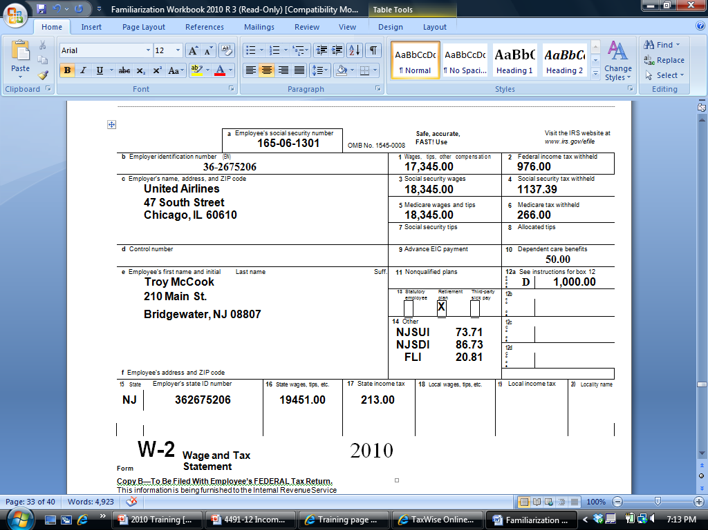
Sample W-2
Federal wages different than SS/Medicare wages
123-06-1301
Dependent care
Douglas Davis
210 Main Street
Bridgewater, NJ 08807
DD
6,350.00
NJSUI 82.67
NJSDI 73.91
NJFLI 19.45
401k Contribution
Box 12 Code DD - Amount for Employer-Provided Health Insurance; not taxable
NJ Wages different than Federal wages
Notes:
This is the source document a working client will present for their wages
A W-2 can be multiple pages
Some interesting things on this W-2:
Federal wages are different than Social Security & Medicare wages
Employee received Dependent Care benefits from employer in Box 10
Employee made a contribution to a 401k plan, indicated by code in Box 12. Notice that amount contributed to 401k pre-tax is difference between Federal wages & Social Security/Medicare wages
NJ box 16 state wages are different than Federal box 1. There is an amount that is pre-tax federal but after- tax NJ. Need to see pay stub to determine what it is. Important if it is medical
Box 12 code DD – shows amount for employer-provided health insurance
Not taxable
Just enter into TS Box 12
7

Slide 8
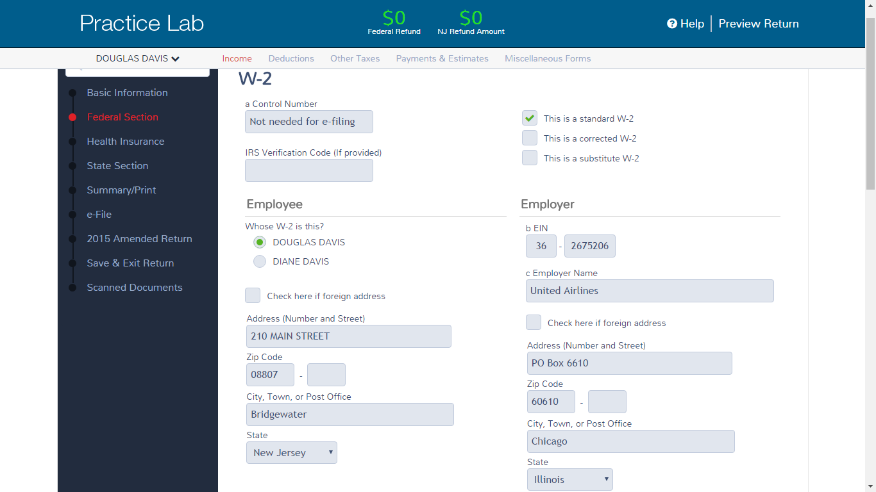
TS – Wages and Salaries Federal Section \ Income \ Enter Myself \ Wages and Salaries (W-2)
Enter EIN; TS may bring up name
& address; correct if necessary
Choose taxpayer or spouse
Verify address;
change if needed
Notes:
8

Slide 9
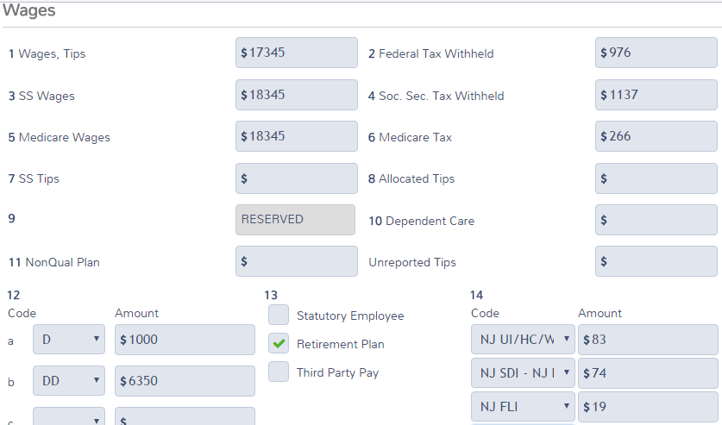
TS – Wages and Salaries Federal Section \ Income \ Enter Myself \ Wages and Salaries (W-2)
(cont'd)
Enter
TS populates; update as
needed
TS does not recalculate Boxes 3-6
based on 401K contribution
Choose from drop-down menu
Notes:
Enter Employer ID & Employer Name & Address (if they don’t come up automatically from entering employer ID - EIN)
Enter Zip Code, & TS will populate city & state
Enter Wages in Box 1
TS will automatically populate SS & Medicare wages/tax withheld in Boxes 3, 4, 5, 6
When Federal wages not = SS or Medicare wages, it is often because of a pre-tax 401k contribution, which is shown in Box 12 as a code D. TS will not automatically change the SS or Medicare wages if you enter code D in Box 12
If you need to changed Box 3 or 5 wages, you must manually correct them. A change in Box 3 will cause TS to re-calculate Box 4; a change in Box 5 will cause TS to re-calculate Box 6
Enter any other #s from W-2 Boxes 2, 7-12
TS will include Allocated Tips from Box 8 in Wages (1040 Line 7)
TS will use Dependent Care Benefits from Box 10 in calculating Credit for Child & Dependent Care Expenses on Form 2441 Part III Line 14
9

Slide 10
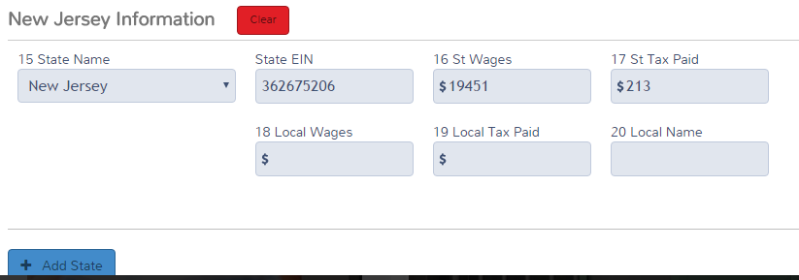
TS – Wages and Salaries Federal Section \ Income \ Enter Myself \ Wages and Salaries (W-2)
(cont'd)
Choose from drop-down
menu
TS transfers from Box 1; update if needed
Add another state if needed
Notes:
Enter NJSUI (Unemployment), NJSDI (Disability), & NJFLI (Family Medical Leave) amounts in TS Box 14 (even if they are someplace else on W-2)
On some W-2s, WF or SWF (Work Force Development – a portion of Unemployment NJSUI) is separated from Unemployment. When entering in TS, add WF/SWF & Unemployment together & enter in box 14 under NJSUI
TS will include the amounts entered in Box 14 in State/Local Taxes you paid on Sch A Itemized Deductions
Private plans, indicated by PP#, cannot be claimed on Sch A. Therefore, must choose “Other” from drop-down menu in Box 14 so that amount does not flow through to Sch A. Entries under “Other” will also not flow through to NJ Form 2450 for excess contributions to unemployment, disability, or family leave
If other entries in this box, such as 414h, choose “Other” for Box 14. They do not flow through to Sch A
If more items are in box 14 of the W-2 than there is room for on the TS W-2, combine them together and enter on the open line
Enter State ID #
TS automatically enters State Wages in Box 16 (based on Federal wages)
If State Wages on W-2 is different than TS populated, must manually change the state wages
Enter State Tax Withheld from Box 17
10

Slide 11
Wages and Salaries - TS Tips
Enter all data fields from W-2
TaxSlayer data must exactly match W-2 form
Except for Box 14 NJ special taxes; choose from drop-down menu instead of using W-2 labels
Remember to check taxpayer or spouse box
Verify taxpayer address on W-2
TaxSlayer pre-populates address with info entered in Basic Information section. If address on W-2 is different, make appropriate changes to match W-2
TaxSlayer will populate employer name and address based on EIN entered (if in database)
Verify this info against the W-2 since it frequently changes; makes necessary changes
Notes:
11

Slide 12
Wages and Salaries - TS Tips
(cont'd)
Enter wages in Box 1 and Federal tax withheld in Box 2
TaxSlayer automatically calculates SS & Medicare wages/taxes withheld (Boxes 3, 4, 5, 6). If different than W-2 form, change numbers to match W-2
TaxSlayer does not automatically change SS & Medicare wages if you enter a 401k contribution in Box 12. Must manually correct Boxes 3 & 5
When SS & Medicare wages (Boxes 3 & 5) are changed, TaxSlayer will recalculate SS & Medicare taxes (Boxes 4 & 6). Update if not the same as W-2 (don’t worry about cents since they will be automatically rounded)
If dependent care benefits are shown in Box 10, TaxSlayer adds Form 2441 for Child and Dependent Care credit
Notes:
12

Slide 13
Wages and Salaries - TS Tips
(cont'd)
Box 14 - Must choose appropriate labels from drop-down menu so amounts flow through to Schedule A State and Local Taxes Line 5a automatically
Private Plan for any of these, indicated by PP #, cannot be claimed on Schedule A. Choose Other from Box 14 drop-down menu so that Private Plan amount does not flow through. May also need to adjust NJ-2450 (Excess UI, SDI or FLI) for private plan if more than one W-2 (currently no way to does this in TS. Awaiting 2016 TS)
If other entries on W-2 (e.g.-414H), enter in Box 14 and choose Other from drop-down menu
Can only have 4 lines in Box 14, so may need to add together
Notes:
13

Slide 14
Wages and Salaries - TS Tips
(cont'd)
Choose New Jersey from drop-down menu in Box 15
TaxSlayer automatically populates State Wages in Box 16 with Wages amount from Box 1
Update State Wages as necessary to match W-2
If W-2 shows wages from another state, click Add State button to add that data
Notes:
14

Slide 15
TS - Excess NJSUI, NJSDI, NJFLI: NJ Form 2450 – Private Plan Disability
Currently no way to add PP # or amount to Form 2450. Awaiting 2016 TaxSlayer
Notes:
When NJSUI, DI or FLI exceed maximum(usually because Taxpayer has multiple W-2s), form NJ 2450 can be used for taxpayer to get the excess collected back
Private Plan disability needs to be added to NJ 2450, and is transferred to NJ1040 line 53

Slide 16
Tip Income
Employees must report tips collected to employer (other than months with less than $20)
Employer reports those on W-2 as Social Security tips in Box 7 and takes out Social Security and Medicare taxes (Boxes 4 & 6) for reported tips
Employer legally must also account for estimated unreported tips (calculated from the difference between the reported tips and a percentage of food & drink sales) That difference must be allocated between all employees, and each employee’s share is reported on the W-2 as Allocated Tips in Box 8

Slide 17
Tip Income
Pub 4012 Page D-9
(cont’d)
Tips that are less than $20 per month do not need to be reported to the employer. However, the employee has to report them as income on Form 4137 if they are not included in allocated tips on W-2
Report in Federal section \ Other Taxes \ Tax on Unreported Tip Income (Form 4137)
Employee must pay Social Security and Medicare Taxes on all Allocated Tips (Box 8 of W-2) and any unreported tips
Enter Unreported Tips in box above Box 12 on W-2
TaxSlayer adds Form 4137 to calculate these taxes
Refer to Pub 4012 Page D-9 for more information

Slide 18
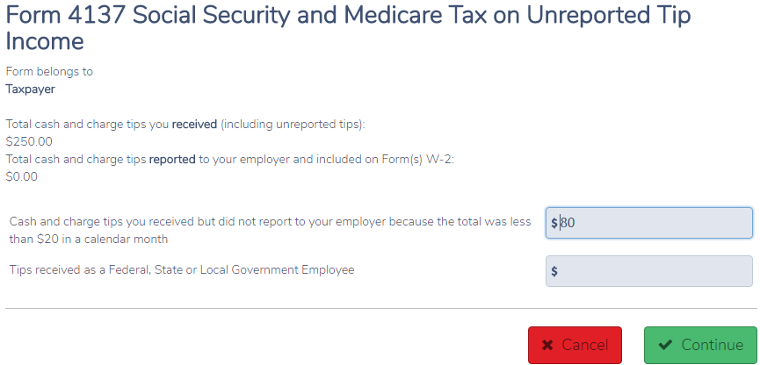
TS – Tax on Unreported Tip Income (Form 4137) Federal Section \ Other Taxes \ Tax on Unreported Tip Income (Form 4137)
Unreported tips entered on W-2 screen
Unreported tips of < $20 in month
Notes:
TS will bring over the unreported entered on the W-2 screen above Box 12
Enter any unreported tips of less than $200 a month on this screen
TS will calculate additional Social Security and Medicare taxes that are due on these unreported tips and transfer that amount to 1040 Line
18

Slide 19
TS – Social Security and Medicare Tax Due on Unreported Tip Income (Form 4137) – 1040 Line 58
Tax due calculated on Form 4137
Unreported tips entered on W-2 screen
SS & Medicare tax due on
unreported tip income
Unreported tips of < $20 in month
Notes:
TS will bring over the unreported entered on the W-2 screen above Box 12 to this screen
Enter any unreported tips of less than $200 a month on this screen
TS will calculate additional Social Security and Medicare taxes that are due on these unreported tips and transfer that amount to 1040 Line 58
19

Slide 20
Federal Pre-Tax Medical Insurance Expenses
Pre-tax medical insurance through employer
Taxpayer pays premiums with before-tax money, reducing taxable wages
W-2 Box 1 shows Federal Wages after pre-tax health insurance premiums are subtracted
Taxpayer receives tax benefit of reduced wages, so can’t itemize as medical expense on Schedule A
NJ does not consider these premiums pre-tax, so W-2 Box 16 shows gross State Wages
Difference between Federal and State Wages on W-2 a clue that Taxpayer paid pre-tax premiums. Probe with client
May be able to claim premiums as medical expense on NJ 1040 Line 30

Slide 21
Federal Pre-Tax Medical Insurance Expenses (cont’d)
Obtain pre-tax medical expenses from taxpayer’s last pay stub for year
Identify which pre-tax deductions are medical. Can be other things too
These pre-tax benefits are often called Cafeteria or Section 125 plans
Allow taxpayer to choose personalized mix of benefits (medical, dental, vision, legal services, day care, etc.) under Section 125 of the tax laws
Note pre-tax medical amount on NJ checklist for later entry in the TaxSlayer State section as after-tax medical expenses

